Slide 1

Two Directions?
How has the evolution of Wikipedia revision activity surrounding Harry Styles and Louis Tomlinson over the past 10 years reflected their diverging public personas and careers?

Slide 2
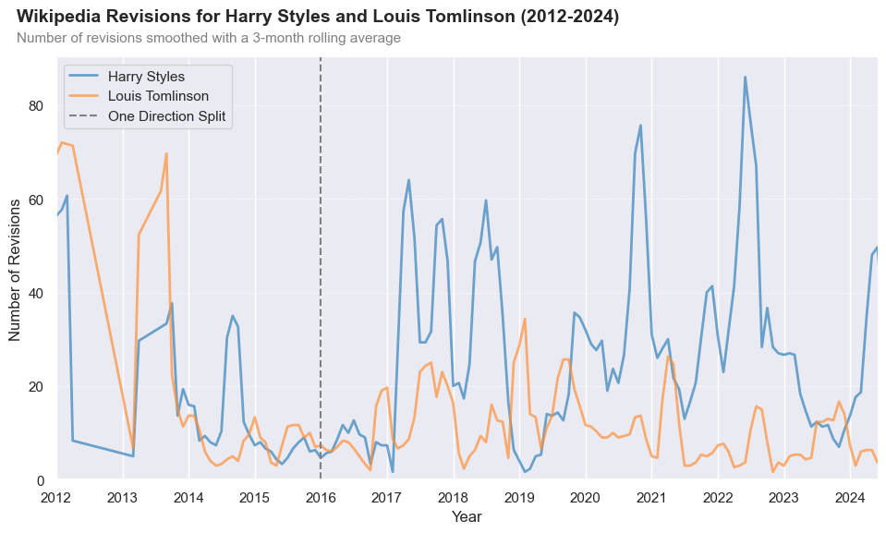
Major career events correspond to spikes in Wikipedia revisions – strong divergence in revision size observed since 2017 (Harry’s First Album)
Harry Styles’ 3rd Album
Rise in Popularity During COVID-19 (TikTok)
Harry Styles’ Solo Debut
Louis Tomlinson’s five new singles
Notes:
JUSTIFYING DATA VIZ CHOICES:
To visualise the temporal trends in Wikipedia revisions, we first aggregated the data on a monthly level and then applied a 3-month rolling average. This approach was chosen as using monthly data alone or applying a rolling average to daily data resulted in too much noise. Since we are interested in looking at major changes in revisions, this method allows us to smooth out short-term fluctuations while capturing relevant career/solo events more clearly.
2012-2014: High number of revisions → One Direction active
2015-2016: Low number of revisions → One Direction went on hiatus
2017- : General divergence in number of revisions
Harry Styles → Peaks in revisions in 2017 (aligns with the release of his first solo single and debut album) and at the end of 2020 (“Watermelon Sugar” breakout hit on TikTok, Vogue Cover controversy?)
Louis Tomlinson → Small peak in 2019 when he released five singles

Slide 3
Part I: Time-series Analysis of Wikipedia Activity
Theoretical background:
The reconstruction of celebrity’s persona can reshape media engagement and public reputation (Marshall et al., 2015; Marshall, 2014)
Pursuing a solo career reflects to the theoretical framework of persona reconstruction
H1: Building a solo career leads to an increase in Wikipedia page revisions

Slide 4
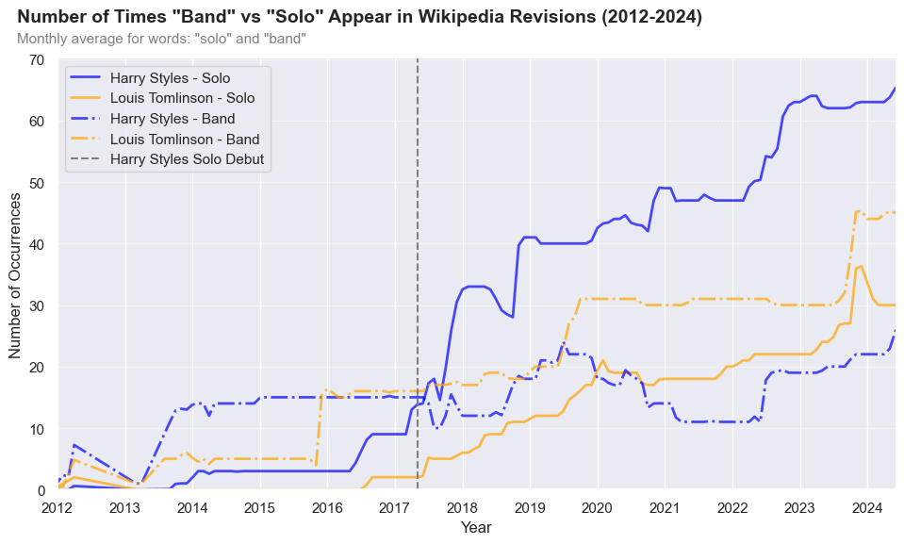
Since 2017, the term “solo” appears more frequently on Harry Styles’ Wikipedia page, while “band” is more common on Louis Tomlinson's page, reflecting their diverging celebrity persona
Notes:
Since 2017, the frequency of the words "solo" and "band" on Harry Styles' and Louis Tomlinson's Wikipedia pages has diverged.
The term "solo" is used more frequently in reference to Harry Styles, while the term "band" is more commonly associated with Louis Tomlinson (since 2017) → differences in perception

Slide 5
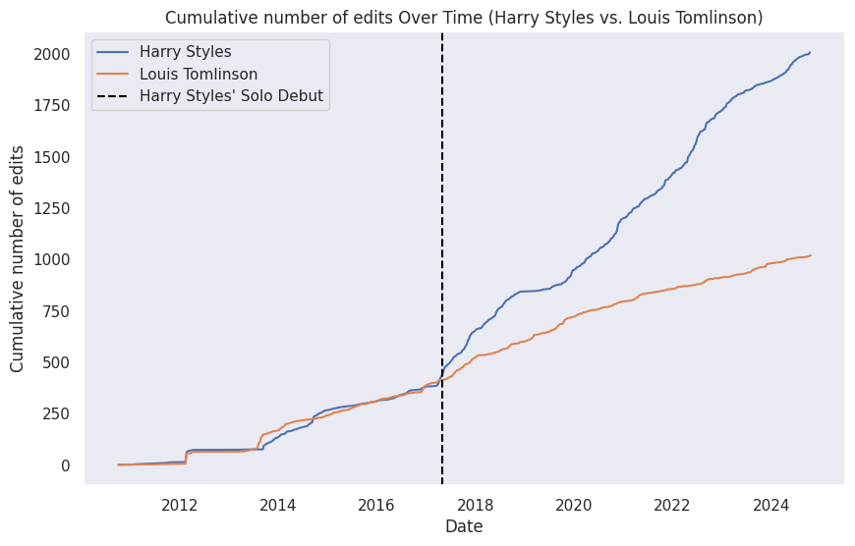
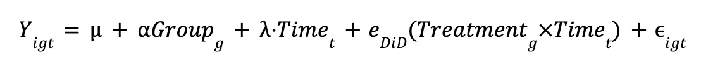
Building a solo career increases the compounded number of revisions
H1: Building a solo career leads to an increase in the activity of a Wikipedia page
Model results
Coefficient
p-value
Intercept
548.394
0.000
Treatment Group
-67.508
0.276
Post Treatment
787.465
0.000
DiD
959.173
0.000
*n = 855
** Adjusted R-squared: 0.661
Difference-in-differences Formula:
Notes:
We observed that cumulative Wikipedia edits for two artists followed a similar trajectory until May 2017, when Harry Styles released his first solo album—an event we defined as the beginning of his solo career.
To assess the impact of this release on Wikipedia activity, we used a difference-in-differences (DiD) analysis. This method compares changes over time between two groups—one that experienced the event (Harry Styles’ page) and one that didn’t—based on the assumption that both would have continued on similar paths without the release, known as the parallel trends assumption.
Our results show a positive, statistically significant effect of the album release on Harry Styles' Wikipedia activity, supporting the hypothesis that it drove a substantial increase in user engagement.

Slide 6
Part II: Different Types of Contributors
Theoretical background:
A small fraction of editors - Wikipedians - do most of the work and produce most of the value (Panciera et al., 2009)
H2: The distribution of contributors’ edits follows a power law distribution

Slide 7
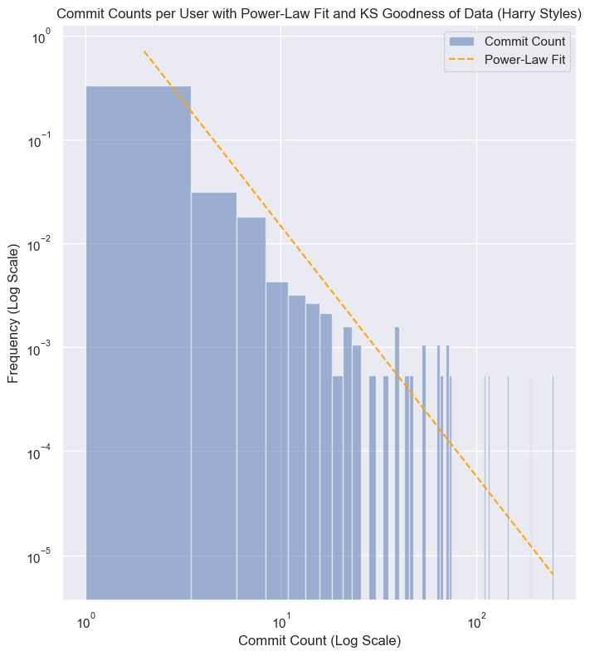
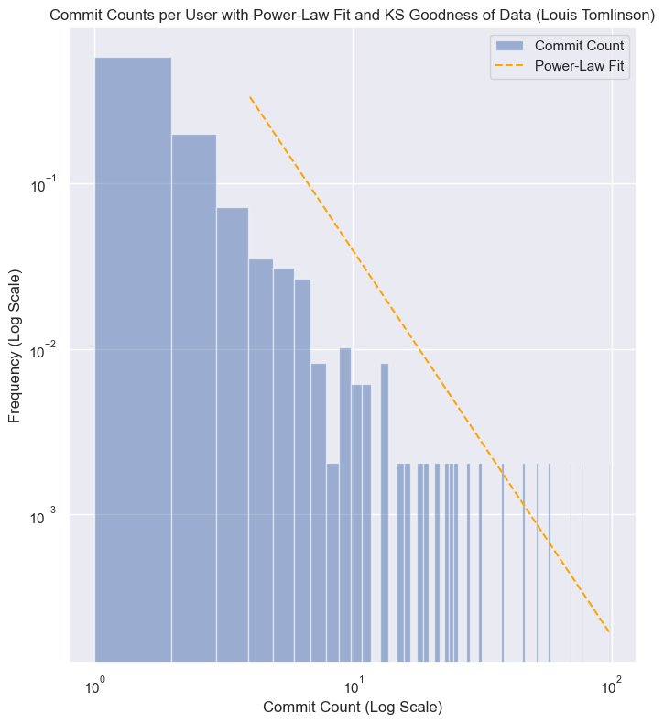
The distribution of revisions follows a power law and the top 5% of contributors are classified as superfans
Notes:
KS test statistic suggests that the sample distribution is very close to the reference distribution, in our case the power-law, with Louis’s revisions slightly following the powerlaw more

Slide 8
Part III - How do ‘superfans’ behave?
Theoretical background:
There are different hierarchies of fans (superfans being on top) who have different levels of knowledge and engagement (Edlom & Karlsson, 2021)
H3: ‘Superfans’ write longer revisions than casual contributors
Notes:
H3b: Superfans make revisions over long periods of time (if not enough time already filled hahah

Slide 9
Average revision length is higher for superfans compared to other contributors, at least for Louis
Mann-Whitney U Test
Harry
Louis
Harry
Object of Inquiry (n)
Superfans (35)
Non-superfans (724)
Superfans (25)
Non-superfans (472)
Average Edit Size
177
92
176
92
p-values
0.82
5.63e-07
Notes:
Underlying analysis:
Shapiro Wilks test was conducted to test if edit size is normally distributed for both artists → test revealed that the data is NOT normally distributed
Descriptive statistics between editor type and length of revision were derived.
Non-parametric Mann Whitney U test was conducted to test for a relationship between editor type and length of revision → test revealed a significant relationship for Louis, but not for Harry
“Negative edits”* were filtered out to test if superfans make longer “additions” and steps 2 and 3 were repeated with this dataframe →test revealed significant relationship for both
*The measure for average edit size is distorted by text removals from the Wikipedia. All text removals (negative text edit values) are therefore filtered out when considering the average “addition size” for both artists.

Slide 10
A restricted sample size and potential biases constitute limitations of the conducted analysis
Research design
Research design does not allow for causal interpretation in regard to all hypotheses
Sample selection
Other members of the band have been disregarded
Data
Bots in the dataframe for users
Limited number of superfans
Large changes in text size can distort the analysis
Operationalisation
We do not know if superfans are Wikipedians first or superfans first
Length of edits could be independent from quality

Slide 11
We have gathered partial support for our hypotheses, however, there is potential for future research
H1: Building a solo career leads to an increase in Wikipedia page revisions
Supported
H2: The distribution of contributors’ edits follows a power law distribution
Supported
H3: Superfans’ write longer revisions than casual contributors
Limited support
Potential for further research
Unit of Analysis
User
Revision
Potential
Examining superfan behavior in other articles
Exploring the type of changes made by superfans and non-superfans via text analysis

Slide 12
Bibliography
Edlom, J., & Karlsson, J. (2021). Keep the fire burning: Exploring the hierarchies of music fandom and the motivations of superfans. Media and Communication, 9(3), 123-132.
Marshall, P.D. (2014). Persona studies: Mapping the proliferation of the public self. Journalism, 15(2), pp.153-170.
Marshall, P.D., Moore, C. and Barbour, K. (2015). Persona as method: exploring celebrity and the public self through persona studies. Celebrity studies, 6(3), pp.288-305.
Panciera, K., Halfaker, A., & Terveen, L. (2009). Wikipedians are born, not made: a study of power editors on Wikipedia. In Proceedings of the 2009 ACM International Conference on Supporting Group Work (pp. 51-60).

Slide 13
Appendix A - Mann Whitney U test for edit / addition size
Descriptive Statistics
 | Harry Styles |  | Louis Tomlinson
Editor type (n) | Superfans (35) | Non-superfans (724) | Superfans (25) | Non-superfans (472)
Average edit size | 177 | 92 | 176 | 92
Average “addition” size* | 658 | 318 | 411 | 475
Mann-Whitney U test
 | Harry Styles |  | Louis Tomlinson
 | U statistic | P-value | U statistic | P-value
Average edit size | 505999 | 0.813 | 41456 | 5.63e-07
Average “addition” size* | 215625 | 7.17e-18 | 52897 | 0.0024

Slide 14
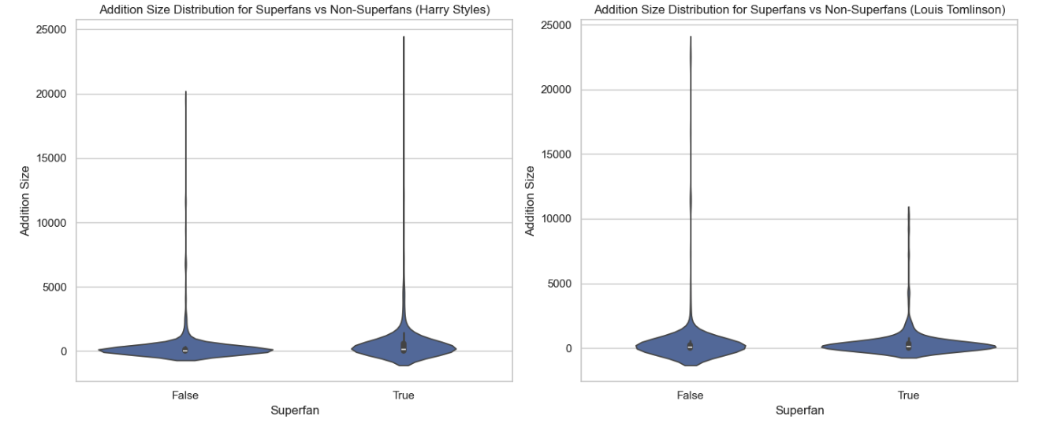
Appendix B - Addition size distribution

Slide 15
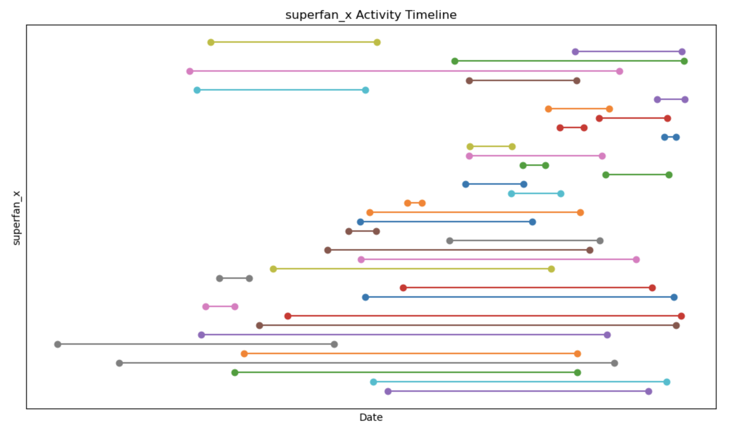
Appendix C - Superfan involvement / commitment
Harry Styles - superfan activity timeline (from first revision to last revision)

Slide 16
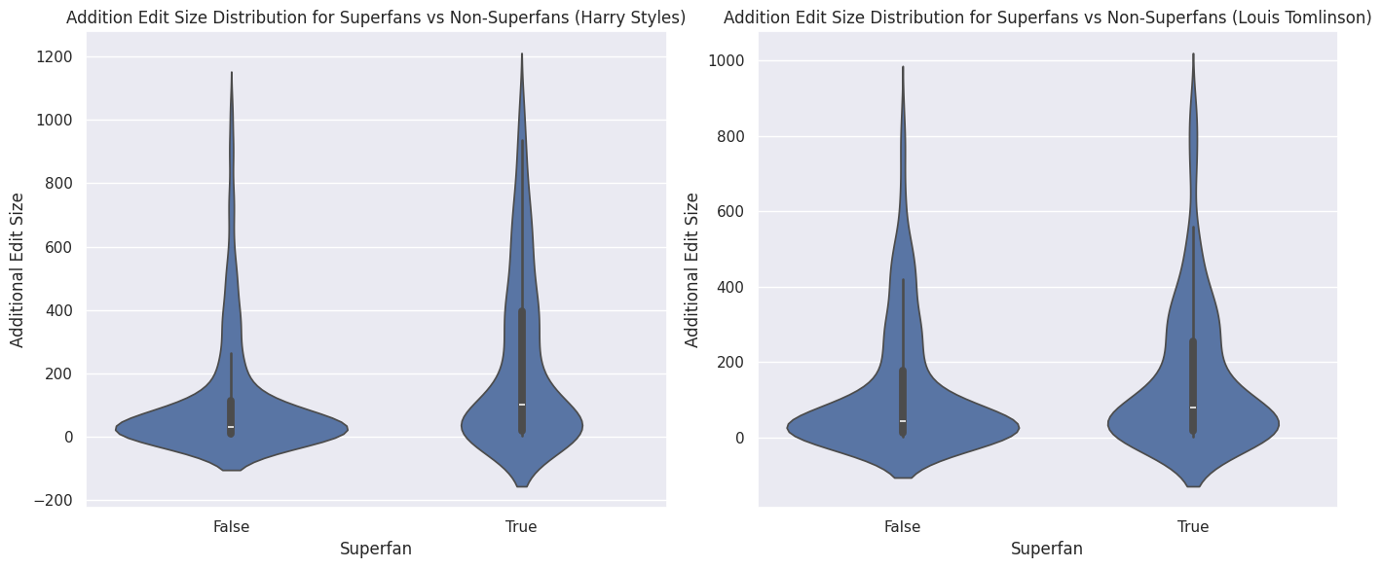

Slide 17
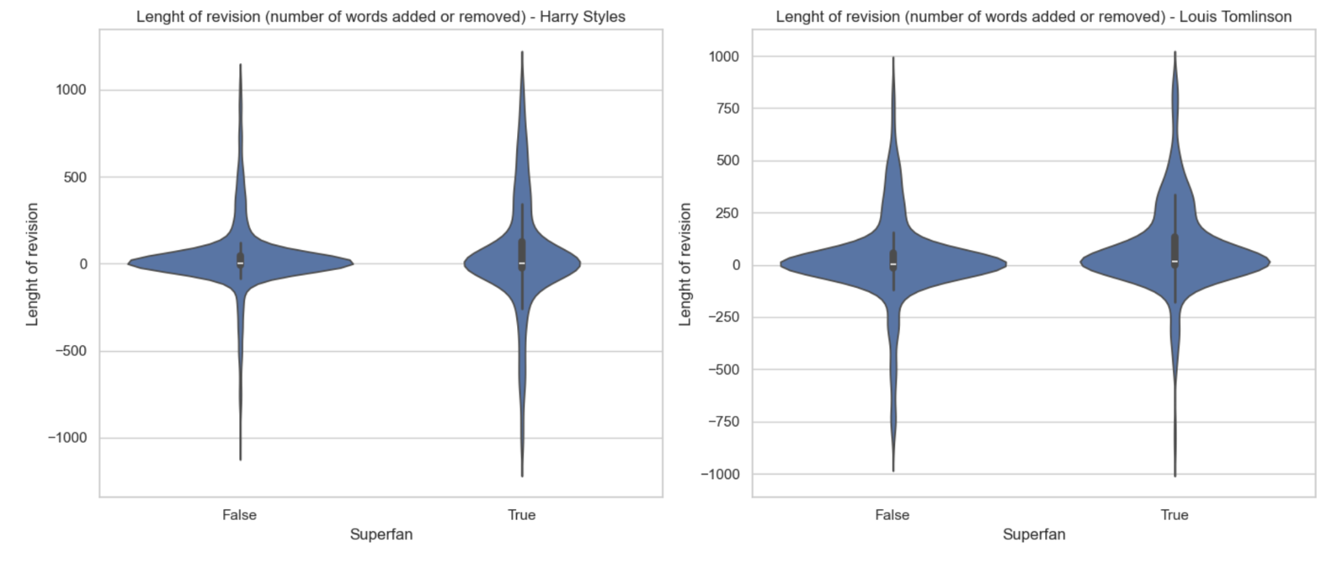
Average revision length is higher for superfans compared to other contributors
Mann Whitney U Test
n = x
Test results data
Harry
Louis
Superfans
177
176
Casual editors
92
92
Notes:
Just trying

Slide 18
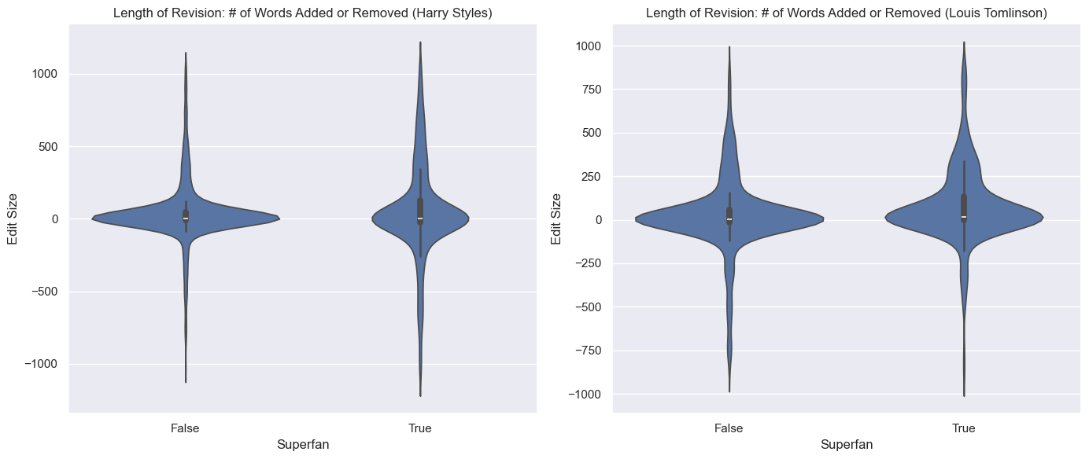
Average revision length is higher for superfans compared to other contributors
Harry Styles
 | U statistic | P-value
Avg. edit size | 505999 | 0.81
Avg. “addition” size | 215625 | 7.17e-18
Louis Tomlinson
 | U statistic | P-value
Avg. edit size | 141456 | 5.63e-7
Avg. “addition” size | 52897 | 0.00245
Harry
Louis
Harry
Editor type
Superfans (35)
Non-superfans (724)
Superfans (25)
Non-superfans (472)
Avg. edit size
177
92
176
92
Avg. addition size
658
318
411
475
Notes:
Just trying

Slide 19
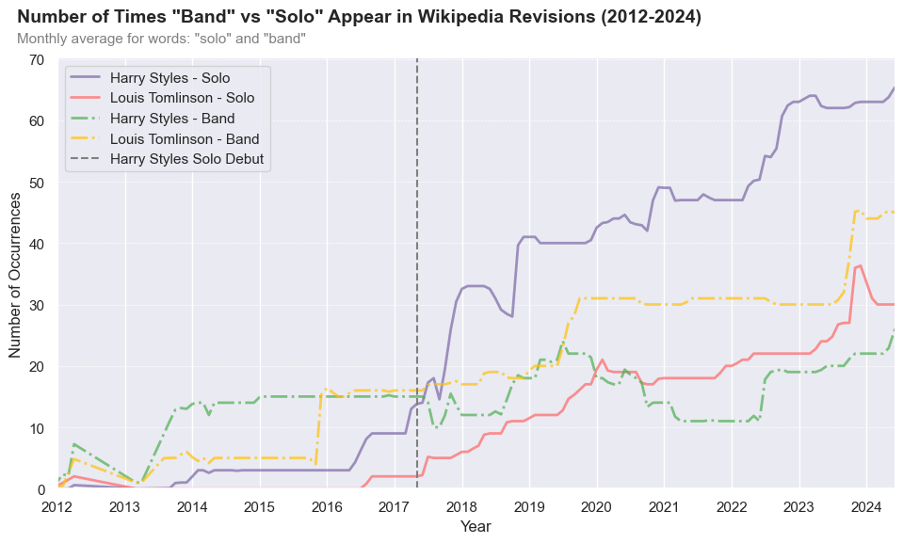

Slide 20
Average revision lenght is higher for superfans compared to other contributors
Mann Whitney U Test
n = x
Test results data
 | Harry Styles |  | Louis Tomlinson
Editor type (n) | Superfans (35) | Non-superfans (724) | Superfans (25) | Non-superfans (472)
Average edit size | 177 | 92 | 176 | 92
Average “addition” size* | 658 | 318 | 411 | 475
Notes:
*The measure for average edit size is distorted by text removals from the Wikipedia. All text removals (negative text edit values) are therefore filtered out when considering the average “addition size” for both artists.

Slide 21
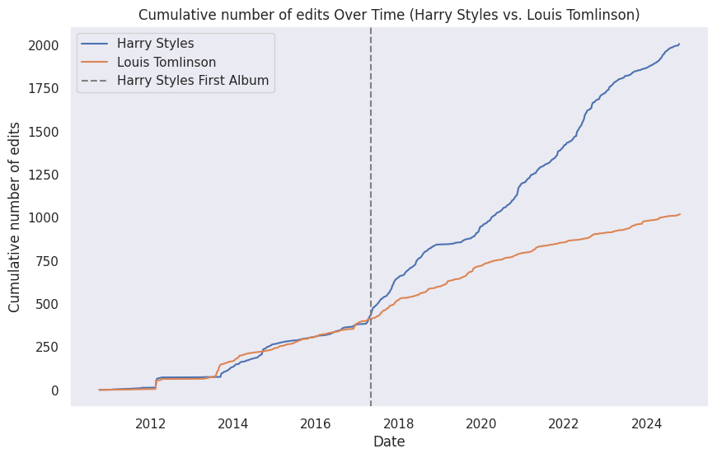
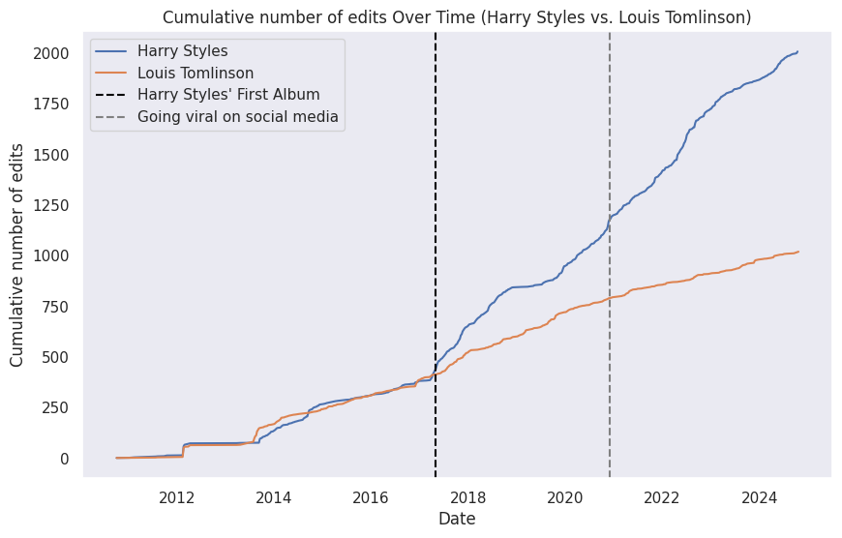
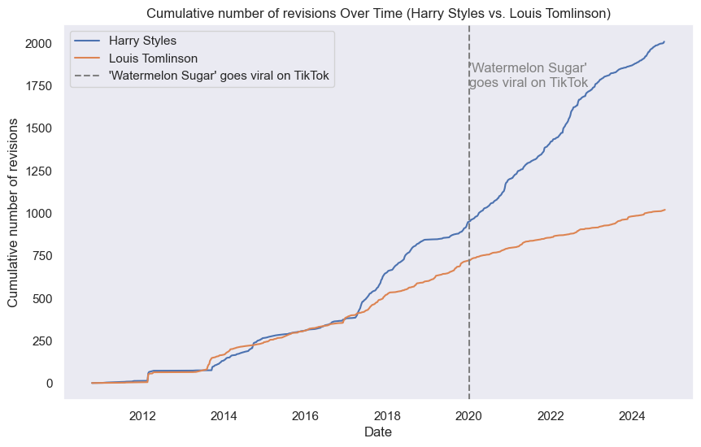
Need group decision

Slide 22
Average revision length is higher for superfans than for other contributors, when disregarding text removals
Harry
Louis
Harry
p-values**
Harry
Object of inquiry (n)
Superfans (35)
Non-superfans (724)
Superfans (25)
Non-superfans (472)
Harry
Louis
Avg. edit size
177
92
176
92
0.82
5.63e-07
Avg. addition size*
658
318
411
475
7.17e-18
0.0024
*The measure for average edit size is distorted by text removals from the Wikipedia. All text removals (negative text edit values) are therefore filtered out when considering the average “addition size” for both artists.
**Non parametric Mann-Whitney U Test
Notes:
Underlying analysis:
Shapiro Wilks test was conducted to test if edit size is normally distributed for both artists → test revealed that the data is NOT normally distributed
Descriptive statistics between editor type and length of revision were derived.
Non-parametric Mann Whitney U test was conducted to test for a relationship between editor type and length of revision → test revealed a significant relationship for Louis, but not for Harry
“Negative edits”* were filtered out to test if superfans make longer “additions” and steps 2 and 3 were repeated with this dataframe →test revealed significant relationship for both
*The measure for average edit size is distorted by text removals from the Wikipedia. All text removals (negative text edit values) are therefore filtered out when considering the average “addition size” for both artists.

